Slide 1
AERO 999
Independent Research
Weekly-ish Status Update
Tim Coon
2 Feb 2015

Slide 2
Overview
Review Task
Status update
Upcoming Conferences/Papers
Research Review Status
Calendar Review
Open Topics

Slide 3
Administrative Items
Qualifying Exams:
EENG 765: awaiting feedback
MECH 622: awaiting feedback
Optical Control: In Progress
Upcoming events:
10 Feb: deadline for AIAA space abstracts
Notes:
----- Meeting Notes (2/2/15 09:56) -----
What classifies as an abstract for AIAA?

Slide 4
New Tasks (1/1)

Slide 5
Task Review (1/7)
Task 1: Literature Review
Dongbin Xiu
Numerical Methods for Stochastic Computations
High-Order Collocation Methods for Des with Random Inputs
Dan Simon
Optimal State Estimation
Zemax (Optical Studio)
Adaptive optics example

Slide 6
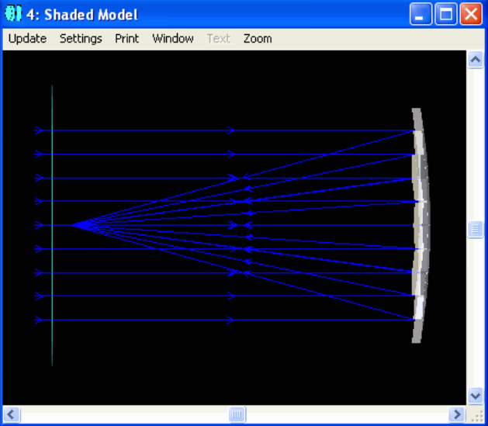
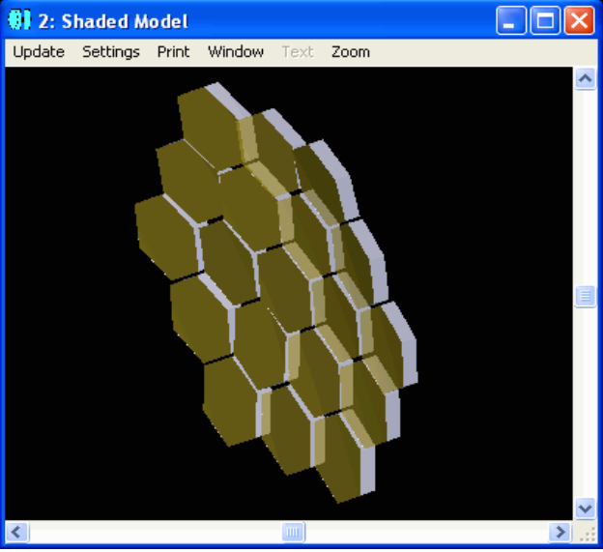
Task Review (2/7)
Task 2: Zemax Optimization
Simulate the nominal system and choose variables
Add atmospheric aberrations
Monte Carlo simulation with normally-distributed RVs. Zemax chooses the static design (Tip/Tilt of mirror segments) to yield best performance given the random aberrations and a user-defined merit function

Slide 7
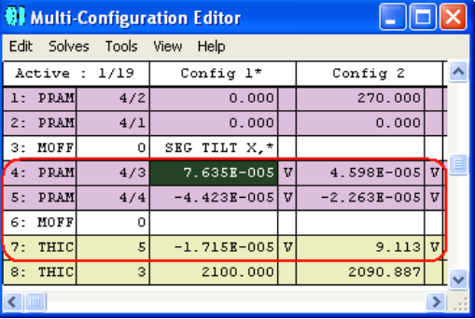
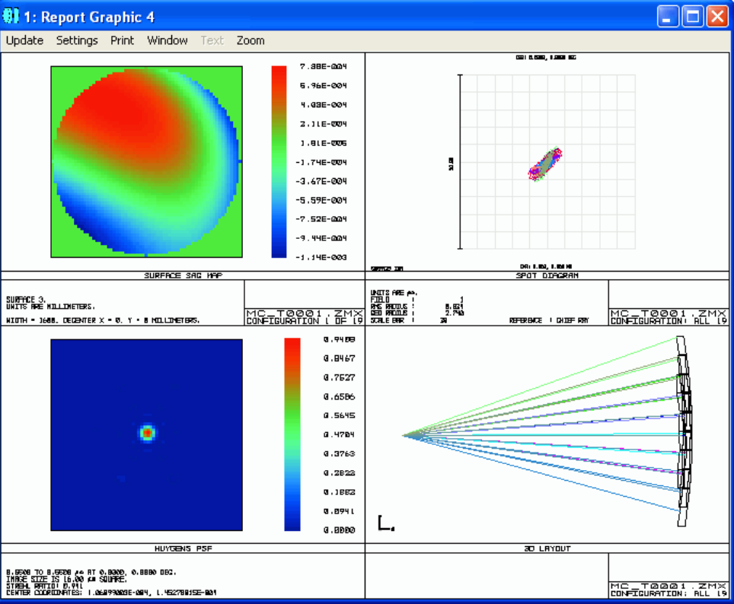
Task Review (2/7)
Task 2: Zemax Optimization

Slide 8
Task Review (2/7)
Task 2: Zemax Optimization
Thus, Zemax provides an optimal static design given a stochastic definition of the perturbed state. There are two (maybe more) limitations that Zemax optimization cannot address.
Zemax cannot optimize parameters that change the stochastic definition of the perturbed state.
(Mathematical Statement)
For consideration of jitter (frequency of disturbance >> frame rate), the evolution of the disturbance has an effect and Zemax cannot model the dynamics over time (I don’t think so, anyway).
Research how to quantify the image degradation as a function of PSF evolution.

Slide 9
Task Review (3/7)
Task 3: Parameter Optimization Paper
Assume image degradation is accumulative. There should be a crossover point in time to compare with the exposure time required.
SNR determination
SNR increases with exposure time
SNR decreases with jitter

Slide 10
Task Review (4/7) {1/3}
Task 4: Prism System ID
Burl, page 41 “Note that the plant must be observable to perform observer design via the given pole placement methodology.”
Does this mean there are other methodologies where an observer can be designed without meeting observability criterion? Perhaps something utilizing uncertainty. (i.e. 99% confident that the state is between 1.1 and 1.2)
What is the ideal system matrix to obtain controllability given a sparse output matrix?

Slide 11
Task Review (4/7) {2/3}
Task 4: Prism System ID
Output Vector
Line-of-sight Model
SPARSE

Slide 12
Task Review (4/7) {3/3}
Task 4: Prism System ID
Have to build a system matrix, A.
Line-of-sight Output Model
SPARSE

Slide 13
Task Review (5/7)
Task 5: Generalized Polynomial Chaos
Working through Xiu text to learn this theory. The goal is to define output statistics given stochastic definition of disturbance.
Notes:
----- Meeting Notes (2/2/15 09:36) -----
FIND REFERENCE TO PROBLEMS WITH QUASI-STATIC ASSUMPTIONS IN ADAPTIVE OPTICS
QUASI-STATIC
KINEMATIC
KINETIC

Slide 14
Task Review (6/7)
Task 6: Zemax Model
PROGRESS:
None
NEXT:
Simulate a deformable mirror in Zemax OAM model
Assess any performance gains changing curvature and, therefore, focal length using deformable mirror for a dynamic-range space-based observer
Especially in an OAM, significant change in focal length via a translation stage causes more risk than a DM
Notes:
Robert D Fiete – Image Quality

Slide 15
Task Review (7/7)
Task 7: DM AO
PROGRESS:
None
NEXT:
Space-Based AO using deformable mirror
Misalignment in an OAM causes more than just tip/tilt error and will most likely require DM OA to control higher-order wavefront errors caused by slew flexing, vibrations, thermal deformations
e.g. when I put a slight pressure on the OAP, significant coma/defocus/astigmatism was observed

Slide 16
Calendar Review
FEB
MAR
APR
MAY
JUNE
JULY
AUG
SEPT
Hard Dates:
Proposed Dates:
June 2015 | Prospectus Defense

Slide 17
Desired Progression
Optical state estimation of prism assy
Simulation
Experiment
Linear and nonlinear model of CTEx telescope
Verify CTEx telescope model by experiment
AO for CTEx? If chromatic aberration from lens is causing problems, then what about atmospheric aberrations in terrestrial testing?
Optimize hardware for slewing and jitter control
Optimize hardware for higher-order AO

